Slide 1
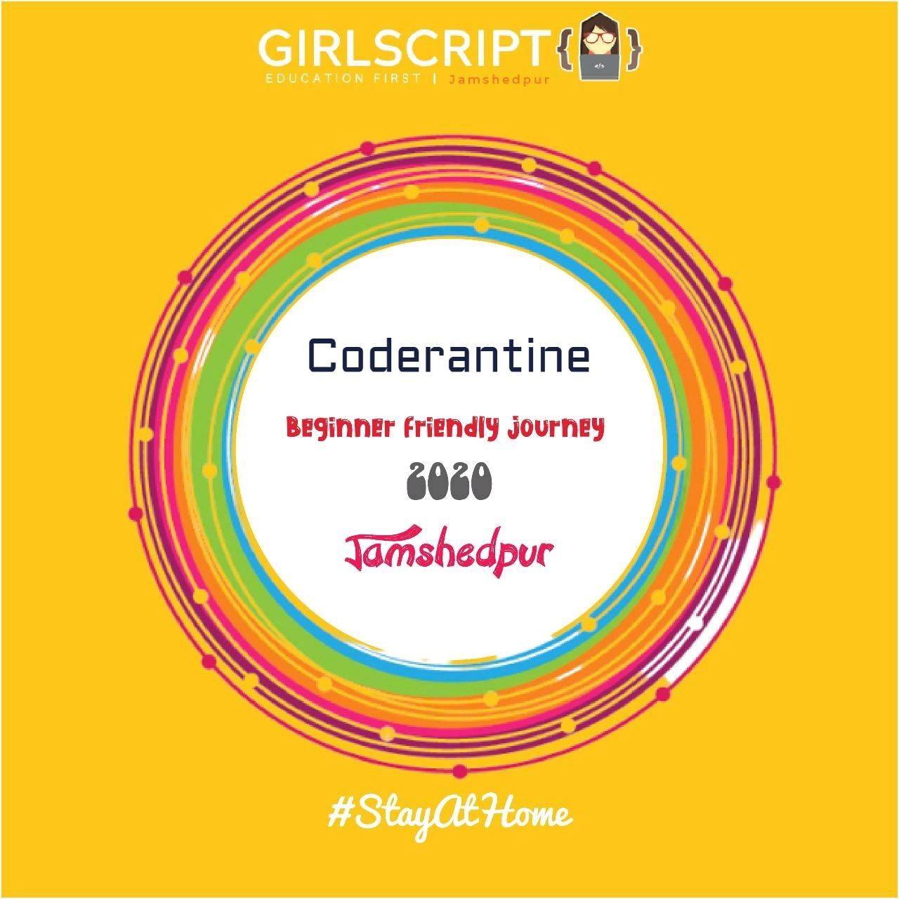
Python Programming
Day 1

Slide 2
Python
The language of the future…..

Slide 3
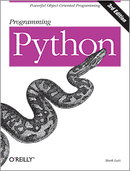
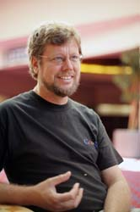
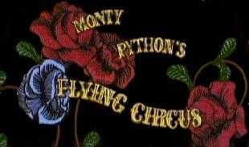

Python is the language of the Python Interpreter and those who can converse with it. An individual who can speak Python is known as a Pythonista. Nearly all known Pythonistas use software initially developed by Guido van Rossum.

Slide 4
Python setup
Visit Anaconda.com/downloads
Select Windows/OSX/Linux
Download the .exe installer
Open and run the .exe installer
Open the Anaconda Prompt and run some python

Slide 5
Variables
Variable in python is created as soon as a value is assigned to it. It does not need any additional commands to declare a variable in python.
There are a certain rules and regulations we have to follow while writing a variable-

Slide 6
The variable name cannot start with a number. It can only start with a character or an underscore.
Variables in python are case sensitive.
They can only contain alpha-numeric characters and underscores.
No special characters are allowed.

Slide 7
x = 10
#variable is declared as the value 10 is assigned to it.
name=”Coderantine”
#this is a string assigned to variable name

Slide 8
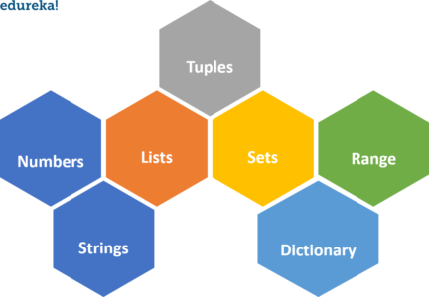
DATA TYPES IN PYTHON

Slide 9
Numerical Data Types
Numerical data type holds numerical value. In numerical data there are 4 sub types as well. Following are the sub-types of numerical data type:
Integers
Float
Complex Numbers
Boolean

Slide 10
Some basic built in data structures in python:
>> Lists : are used to store data of different data types in a sequential manner. There are addresses assigned to every element of the list, which is called as Index. Example: my_list = [1, 2, 3, 'example', 3.132]
>> Dictionary: are used to store key-value pairs. Example: my_dict = {1: 'Python', 2: 'Java'}

Slide 11
>> Tuples: re the same as lists are with the exception that the data once entered into the tuple cannot be changed no matter what. The only exception is when the data inside the tuple is mutable.
Example: my_tuple = (1, 2, 3)
>> Sets: are a collection of unordered elements that are unique. Meaning that even if the data is repeated more than one time, it would be entered into the set only once.
Example: my_set = {1, 2, 3, 4, 5, 5, 5}

Slide 12
Strings in Python
Strings are the most common data type in python.
We can declare a string simply by enclosing a text with single(‘ ‘) or double(“ “) quotations. For example: var1=”Hello World” str1=’This is a string’
To print a string, simply use print function: print(var1), print(str1)
Or simply type in the string: print(“ This is a string”)

Slide 13
Indexing and Slicing
>> Indexing refers to accessing a particular index of a given string. Example: Line=”Python Programming” print(Line[2]) will print t print(Line[-1]) will print g.
>> Slicing refers to accessing a particular section of a string. Line[0:4] will return Pyth. (Note:- It will access elements from (0-3) only) Line[:7] will grab all the elements from the start till index 6. So, it will return Python Line[7:] will garb all the elements from index 7 till end. Hence it will return Programming.

Slide 14
Some important and most commonly used built in methods of Strings:
>> upper() :Converts lowercase letters in string to uppercase.
>> lower() : Converts all uppercase letters in string to lowercase.
>> len(string) : Returns the length of the string
>> replace(old,new[, max]) : Replaces all occurrences of old in string with new or at most max occurrences if max given.
>> swapcase : Inverts case for all letters in string
>> split(delim=” “) : Splits string according to delimiter str (space if not provided) and returns list of substrings; split into at most num substrings if given.

Slide 15
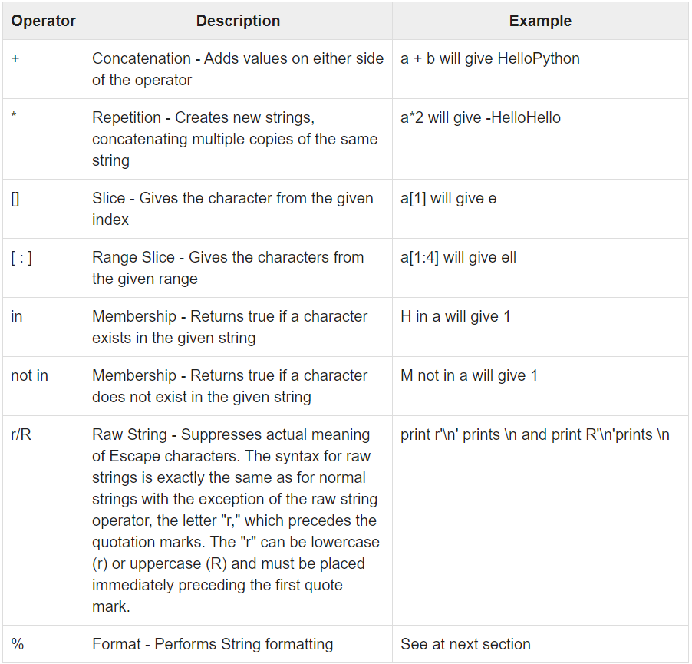
String Special Operators

